Slide 1
Fundamentals/ Principles
of Catholic Social Teaching (CST)
Facilitators:
Rev Fr. Uche OBODOECHINA
Rev Fr. Isaac DUGU

Slide 2
Expectations
What are your Expectations?
What do you expect to learn from the workshop (share).

Slide 3
Solidarity
Association
Equality
Respect for Human Life
Family,
Community,
Participation
The Common Good
Principles of Catholic Social Teaching:
Human Dignity
Subsidiarity
Stewardship
Option for the Poor

Slide 4
Workshop Objectives
To alert us to the fact that the Church’s teaching on social justice is an essential part of our faith.
To become familiar with ten major themes in CST.
To understand the link between these themes and our reality in the Nigerian context
To learn how we can apply the themes and concepts in our everyday life and work.
To motivate us to further action for the good of the individual and society at all levels
Notes:
To raise our consciousness to areas where these principles are needed, where ignored, when and where they should be implemented
To help us identify more with the wounded, disenfranchised, the less fortunate and the vulnerable.
To help us make correct choices, informed decisions and ultimately lead us to be “principled” people in the area of social justice.
To enable us to contribute to the building of a more just and egalitarian society, in fairness and equity-home-workplace
To make us be aware of our responsibilities related to the building, organizing, and functioning of our Church-Agencies, Work demands-Civil society: political, economic, and administrative and reconstruction of the social order and indeed anywhere we find ourselves.
To increase our respect for one another and develop a proper understanding of human life and dignity.
To challenge us to be living examples to others.

Slide 5
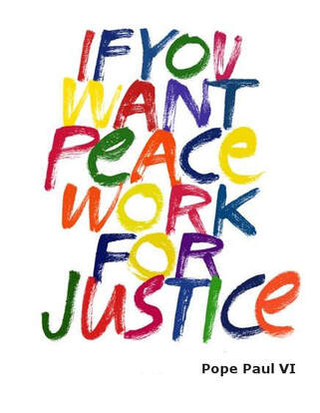
What is Catholic Social Teaching?
The Catholic Social Teaching is about the complex realities of human existence within society and the international order.
Borne out of centuries of careful reflection and illuminated by Faith, Gospel and Church tradition.
Catholic Social Teaching has:
TRUTH as its guide
JUSTICE as its end
LOVE as its driving force (Mater et Magistra no 226-264)
Cardinal Point of CST: The individual person is the foundation, cause and end of all social institutions

Slide 6
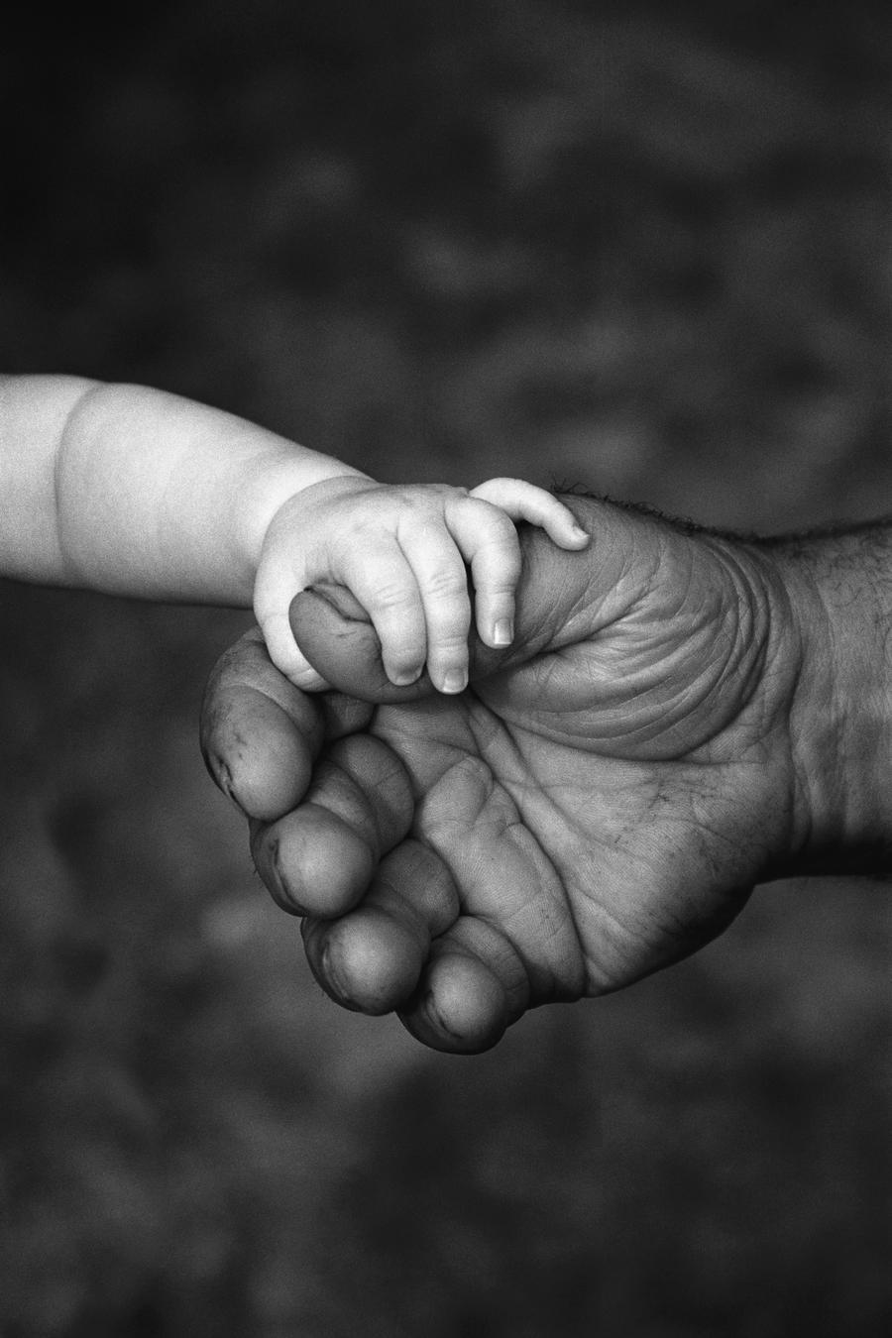
Foundations of Catholic Social Teaching:
Every human being has tremendous dignity as a child of God
No one should suffer discrimination of any form,
God made us himself, in His image;
We are special in God’s eyes
We have a spiritual nature
We are social beings
We possess freedom, and must use it responsibly
We mirror God’s image best when we love one another
God made us co-creators with him
We all have rights and responsibilities

Slide 7
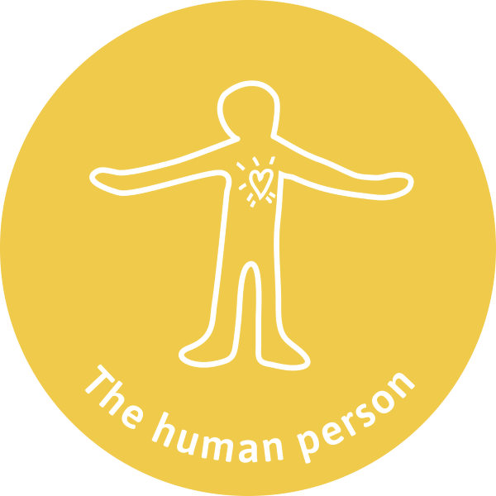
Respect for Human Dignity
The Catholic Church proclaims that every human person has an inherent dignity.
Every person is precious, and people are more important than things.
The dignity of the human person is rooted in their creation in the image and likeness of God.
The foundation, goal of the social order is the human person, conferred on him not from outside but arises from the persons very nature.
Dignity is inalienable – it is not lost due to poverty, age, gender, disability, race and ethnicity, a lack of success, or even criminal behavior.
Human dignity, complete vocation of the person, and the welfare of society as a whole. These are everyone’s responsibility to respect and promote.
Human Beings are unique, unrepeatable, distinct selfhood, Individuality, Rationality, immutability.
Respect for life is every one’s responsibility Institutions/State.
Notes:
A mad person eating on the heap of garbage ,those without shelter, sleeping under the bridge, character assassination, lies against one another,
That the dignity of the human person is the foundation of a moral vision for society and every violation cries out in vengeance to God as well as an offense against the creator. To this we say, the dignity of human person has a transcendent value. The human person is radically oriented towards the creator and in relation to everyone.
This belief is the foundation of all the principles of our social teaching.
That the measure of every institution is whether it threatens or enhances the life and dignity of the human person.
The human person derives His Dignity directly from God (Every human being, regardless).
Human dignity emerges neither from what people accomplish or own.

Slide 8
Respect for Human Life
No one has the right to destroy life. Human life is sacred.
Every person must be protected and respected from conception to natural death (womb to tomb) .
We must take reasonable care of our own physical health and that of others.
The dying have a right to live the last moments of their earthly lives with dignity.
The bodies of the departed must be treated with love and respect.
Respect for human life is a duty, a responsibility toward the lives that have been entrusted to us: our own and those of others.
Respect for human life as part of any moral vision for a just and good society.
Notes:
Procurement of Abortion, Euthanasia come to mind. No one is permitted to ask for this act of killing, either for himself, or for another person entrusted to his or her care, nor the dying person either implicitly or explicitly, nor can any authority permit such an action.
Cruel acts like Kidnapping, (prostitution, human trafficking, indecency) hostage taking; terrorism; torture; violence; direct sterilisation are against human dignity.
We must avoid the cult of the body and every kind of excess
Also to be avoided are the use of drugs, food, alcohol, tobacco and medicine (CCC no. 474).
The transplant of organs is morally acceptable with the consent of the donor and without excessive risks to him or her.
Their cremation is permitted provided that it does not demonstrate a denial of faith in the resurrection of the body (CCC no. 479).

Slide 9
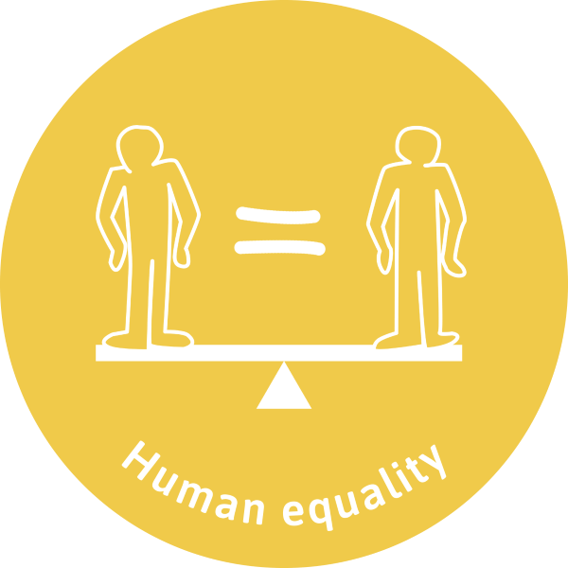
The Principle Of Human Equality
The principle of equality holds that although people have different talents, we are equal because of our fundamental dignity as God’s children.
Equality is an inalienable right of all members of the human family, and is the foundation of freedom, justice and peace in the world.
This principle calls for action to enable those who are disadvantaged to realise their full potential and participate fully in economic, social, political, cultural and civil life.
This aligns with Article 1 of the Universal Declaration of Human Rights which proclaims that all human beings are born free and equal in dignity and rights.
Notes:
How do you feel when escorts of politicians push you off the road?
An experience at the Airport, when the president is travelling or landing, how do you feel?
At the bank on the queue, some persons who came after you are giving special attention leaving you here unattended to
Principle of Human Equality asks the question why are there no school where both children of the rich and poor attend together
Why are there some hospitals meant for the rich and others for the poor,
Why cant we have equal opportunities for everyone irrespective of race, education, religion, ethnicity etc
It also challenges how we are treated based on our class, personality, while others are not recognised.
It abhors any form of discrimination or prejudice as unjust.
Equality as the foundation of freedom, justice and peace in the world.
Article 1 of the Universal Declaration of Human Rights proclaiming that all human beings are born free and equal in dignity and rights
Challenges States to ensure non-discrimination, race, ethnicity, sex, disability, health status, religious belief, career status etc.
That discrimination harms human capabilities, denials of freedom which hinder human development.
It encourages and enable the disadvantaged to realise their full potential, and contribute to their full participation in economic, social, political, cultural and civil life.

Slide 10
Preferential Option For The Poor And Vulnerable
This principle refers to Church’s special love for the poor and vulnerable.
Performing the works of mercy, we are paying a debt of justice (CSDC 184).
This includes all who are marginalized, unborn children, persons with disabilities, the elderly and terminally ill, the powerless, and victims of injustice and oppression.
The poor and vulnerable are equal in rights and in dignity to everyone else.
In performing works of mercy towards the poor, we simply return to the poor what is theirs.
Every person’s needs are important, but special consideration should be given to how the decisions we make impact on the lives of the most vulnerable.
Notes:
Our attention is first directed to those living on the margins of society. Those living on less than a dollar per day, the needy, homeless, those without health care, those without hope for a better future, those without decent housing. This is just an aspect.
This one involves all of us directly, in many ramifications. Other layers of poverty are our unmet desire/aspirations/self actualising needs, esteem needs, acceptance needs, safety needs, self-transcendence needs?
We are all poor in one way or the other. We have poverty of the mind, character, poverty of knowledge, poverty of Christians virtues, love, kindness, forgiveness, truth, peace, poverty of communion life, transparency-accountability, etc.
We are all vulnerable in one way or the other. Mt 19:21. What must I do to inherit the kingdom of God…..

Slide 11
The Principle of Solidarity
That the good of one is the good of all.
Solidarity is opposed to individualism. We are our brothers’ and sisters’ keepers.
Solidarity means learning to love our neighbours, regardless of ethnic, religious and ideological differences.
Solidarity also involves striving to change the socio-economic, legal and political structures that feed inequalities between people and groups.
Solidarity means offering a helping hand to support, empathise, and identify with others in challenging moments and also in joyous moments.
Notes:
Pope Leo XIII calls it principle of friendship, Pope Pius XI refers to it as Social Charity, Pope Paul VI calls it Civilisation of Love, Pope Saint John Paul II and Pope Emeritus, Benedict XVI call it Principle of Solidarity.
Two ways of looking at it: Solidarity that rests on the individual to make available out time, talents and resources for the good of others, secondly, advanced nations to help developing nations/people ex. Scholarships, trainings, capacity building capacity, support a research, fund projects to eradicate malaria for example.
How we help one another to fix small or big problems in family and work place are good examples of solidarity.
In family setting , mutual support of husband and wife.
Those who are more influential should be ready to share with those who are weak, the weak should also inturn should not adopt a passive attitude be do what they can for the good of all.
The human person, human family, is obliged to contribute to the common good of society at all its levels.

Slide 12
The Principle Of Subsidiarity
This principle holds that those in authority should perform only those functions which cannot be performed by those at a lower level.
Citizens should play an active part in determining the political and social reality of their community.
Do not take over and do it for the other: thereby creating learned helplessness or overdependence.
Do not stand back and watch the other struggle to the point of frustration and feelings of hopelessness.
Subsidiarity encourages decentralization, private initiative, and safeguarding of rights.
Notes:
The word subsidiarity is derived from the Latin ‘subsidium’ meaning help, aid or support.
Human person via families and local communities should function autonomously.
It promotes only those actions that "allow all peoples to become the artisans of their destiny" (PP 65).
People should not be deprived of their responsibility.
The capabilities, and initiative of these groups are not destroyed or absorbed into a higher order social organization (CSDC 185; CCC 1882).
It opposes all forms of collectivism, every person has something original to offer to the community.
It encourages private initiative, safeguards human rights and the rights of minorities.
It brings about bureaucratic and administrative decentralization.
It not only sets limits for state intervention, it also challenges States to create favourable atmosphere for economic activity/participation

Slide 13
God created the world and found it very good (Gen 1:31).
We are called to be co creators of the goodness of God by our talents and opportunities we have.
Human beings are stewards to make it fruitful, multiply, subdue, and fill the earth (Gen 1: 28-30).
Anything that is inimical or destructive to this beauty and goodness is to be circumvented.
Anything that enhances human life is to be promoted.
Human being are called as Stewards to make careful and responsible decisions with the resources entrusted to them.
We are called to protect people and the planet such that future generations can inherit a world better than the one we met.

Slide 14
The Principle of Association
The human person is social by nature.
Human beings thrive not as isolated individuals but as part of a rich tapestry of relationships.
Associations may be based on gender, age, ethnicity, profession, religion, organisation, interest, etc.
Association is important to advance the good of members. For example, economic empowerment, credit mobilisation, welfare activities, Unions, CSN Lay Staff Meeting.
Notes:
The human person is not only sacred, but also social.
Aim of Association is to promote and defend the well being of all, especially the most disadvantaged persons or group.
Human beings are not isolated individuals but as part of a rich tapestry of relationships.
Associations are based on gender, interest groups, age, ethnic, professional groups, regional, religious, organisational, sectarian identities, civil groups etc.

Slide 15
The Call to Family, Community and Participation
Participation in family and community life is one of the greatest aspirations of human beings.
People have a right and a responsibility to contribute to the cultural, economic, political, and social life of their community.
It is an injustice to exclude or abandon a member of our family or community.
Everyone including the most disadvantaged must be given a chance to participate.
Participation is one of the pillars of democracy.
Notes:
It’s the moral duty of citizens to contribute-individually or in association they belong to
Marriage and the family are the central social institutions that must be supported and strengthened.
The most disadvantaged must be given a chance to participate.
Violence often times can arise due to people deprivation to participate and shape their lives/destiny
Participation as the pillars of democracy.
We have a responsibility to be shapers of the world in which we wish to live.
The ultimate injustice is for one to be abandoned or excluded.
People have a right to shape their own lives and the society in which they live.

Slide 16
The Principle Of The Common Good
That God created everything “Good” for the good of human beings.
The common good refers to the social conditions which allow people either as a group or individuals to reach their potential and fulfilment more easily,
The common good does not refer only to socioeconomic well-being. It also has a spiritual dimension.
The common good is indivisible: each member participates, and it cannot be divided among the members.
Every member of society is required to work towards attaining and safeguarding this good.
The State (government), public authorities at all levels are bound to respect the rights of the human person with the responsibility to work for the common good.
Notes:
The essential elements of common good are: Respect for the human person, society should permit each of its members to fulfil their vocation-natural freedom-rights to act according to a sound norm of conscience, Secondly, guarantee of social wellbeing. Thirdly, Peace and integral development as indispensable. The ability to stability and security of a just order.
Only together with every member of society is it possible to attain, increase, and safeguard this good.
Not the mere sum of particular goods of each member of society but for all.
The flourishing of all people and of the whole person as its primary goal.
Non-discriminatory in nature, according to each one's possibilities, in attaining it and developing it" (CSDC 167).
The human person has a right to "the material goods that correspond to his primary needs.
The right to use of goods is a natural right, inscribed inherent in human nature
When the common good is been promoted, people are likely to attain their goals/aspirations more easily.

Slide 17
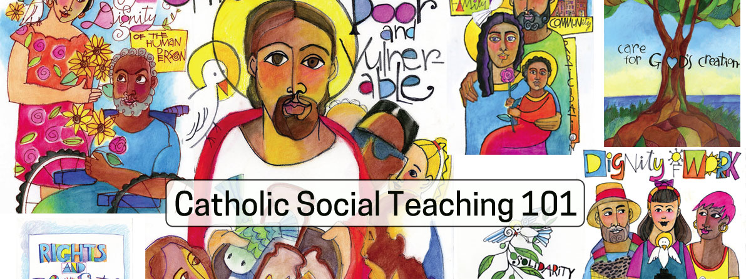
Well Done!
You have finished the basic course on Catholic Social Teaching.
In the intermediate course, we shall discuss the encyclicals relevant to each principle, and the historical setting and events which prompted them.

Slide 18
See-Judge-Act
See: Observe and discuss the situation.
Judge: Evaluate it with respect to CST principles.
Act: Offer suggestions on what should/ought to be done in the circumstances.
Notes:
We shall now be sharing a series of case studies. Teams will be asked to use the See-Judge-Act framework to examine each case study.
See: Observe and discuss the case study.
Judge: Evaluate it with respect to the specific principle.
Act: Offer suggestions on what should/ought to be done in the circumstances.
Then, each group shall make a presentation of the case study.

Slide 19
Human Dignity
A wealthy man in your neighbourhood is known to be associated with armed robbers and kidnappers that have killed and injured many. It is through these activities that he feeds his family and trains his children.
On this day, he was severely wounded in an accident and was rushed to the hospital that you visit weekly as part of your duties. The medical personnel, aware of his nefarious activities, left him lying on the stretcher to bleed to death.
You arrive at the scene of the incident. Do you feel responsible to save his life? If yes, what steps must you take? If no, why do you not want to help him? Discuss both aspects.

Slide 20
Human Life
You are a medical officer at SaveaLife Hospital. A young lady is brought into the hospital by her mother. She was raped by armed robbers two months ago. She is an SS3 student preparing for her WAEC exams.
She is still suffering from the trauma of the rape and has not been able to resume school. Now, she is pregnant. Her mother requests you to perform an abortion on compassionate grounds.
Do you feel obliged to discuss with the mother and daughter, if yes, what kind of discussion, if no, why?
Notes:
Alternative exercise: Human Life:

Slide 21
Association
In your community, there is someone who is committed in the activities of the life of the community, but does not himself relate so well with people. He is already indebted to the local bam.
At this point, he needs money to expand his local dry gin shop that is almost dying. He puts his request for another loan with a commitment to pay back as when due even as his words are not trusted.
As the chairman of this local bam, how will you help him out?

Slide 22
A call to Family, Community and Participation
A family whose home was destroyed by recent inter-tribal conflict has been staying in your community for some months. Return to their ancestral home does not seem possible in the nearest future.
The farming season is at hand, and the community has started clearing their lands. The displaced families have requested for a few rented plots, so they can farm and fend for themselves. They have no money to pay, but hope to settle the debt after the harvest.
As a leader in the community, what would you do?

Slide 23
Preferential Option For The Poor And Vulnerable
A homeless person arrives at your shelter in need of assistance. This individual appears not to have showered in a long time, and clearly lacks proper hygiene. The odour surrounding him is very offensive.
It is your responsibility to conduct an intake interview. How would you proceed?

Slide 24
Solidarity
You are the nurse in charge of a local primary healthcare centre (PHC). A UK-based NGO has donated free baby products to be given to the mothers attending antenatal care at the PHC.
There is a camp in the nearby bush inhabited by the wives and young children of Fulani herdsmen. Some of the Fulani women are pregnant. They show up at the primary healthcare centre requesting to benefit from the distribution of free baby products.
The women of the community try to chase the Fulani women away. According to them, Fulani cattle have been destroying their farms, therefore the Fulani women should not partake in the giveaway.
What will you do and why?

Slide 25
Stewardship
You are given an assignment to draft a proposal requesting for ecological funds. This was to be done within one week with two of your colleagues. You eventually shared the work among each other. Yours was done and the rest didn’t with no justifiable reason. Your boss requests of the work a day to the submission date.
The company will most certainly miss the grants due to your inability to write a proposal. Your boss discovers work undone and gets angry, writes a letter of dismissal to you and your colleagues but a disciplinary panel calls you for explanations.
Do you think this is an opportunity to exonerate yourself. If yes, why and if No, What steps are needed to save your job and those of your colleagues.

Slide 26
Subsidiarity
Your finance assistant Peter as part of his job role is required to have skills in MS Excel. The team is working on an important proposal which is due by 5.00pm. Peter is assigned to work on the budget. He accepts the task without asking for any clarification or support.
By 4.30pm Peter brings you an incomplete, incomprehensive budget. He is anxious to close for the day in order to catch a lift home with another colleague.
What steps will you take 1) immediately, and 2) afterwards?

Slide 27
Human Equality
A cleaner comes to you to complain that she is not receiving medical benefits, unlike others in the company. She approached HR and was told that she is not entitled to medical benefits.
She is afraid to speak up, but she has a sick child and is struggling to cover the medical expenses. She has worked in the company for many years and feels that she should be entitled to medical cover, just like other staff.
As a manager of the company, how will you handle this case?
Notes:
Exercise: A worker based on the little disagreement she had with her employer you learn that she is not being granted the same medical benefits and holiday allowances that are typically given to employees in her position. She is afraid to speak up in fear of potentially being fired but truly needs these monies for her up keep and family needs. Being one of the managers of the company, what steps will you take to mediate in this case?

Slide 28
Exercise: Common Good
You live in a nice duplex in a housing estate in Abuja. You are in the process of relocating to Canada with your family, and will be leaving in a week’s time.
The transformer that serves the entire estate has broken down beyond repair. The residents decided to levy themselves to buy a new one. Those in duplexes will pay N300,000 each, those in bungalows N250,000 and those in flats N150,000.
You have a backup generator that you are using in the meantime to power your appliances.
How will you respond to the request to pay up your levy?

